Slide 1
Federal Political Financing in Canada 2004 - 2013
Satish Terala, Will de la Guardia, Tim Groves, Robert Palinic, Houtsin Diep

Slide 2
Contents
Contributions by Party from 2004 – 2013
Estate Breakdown by Party
Top Individual Donations 2013
Provincial Funding Balance
Appointee, Ambassador, Lobbyist, Donations by Party 2013

Slide 3
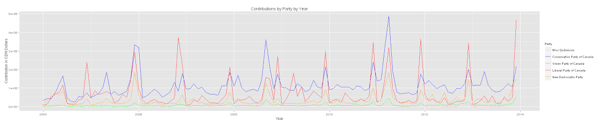

Slide 4


Slide 5
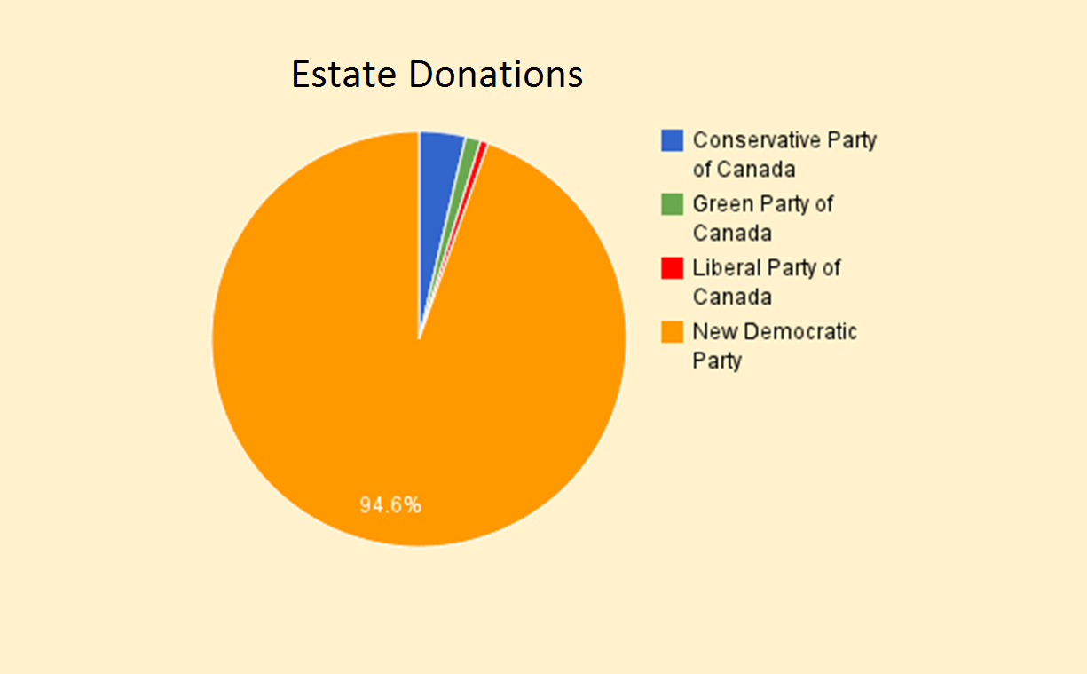
http://www.cbc.ca/news/politics/elections-bill-s-cap-on-estate-donations-may-hit-ndp-1.2523366

Slide 6
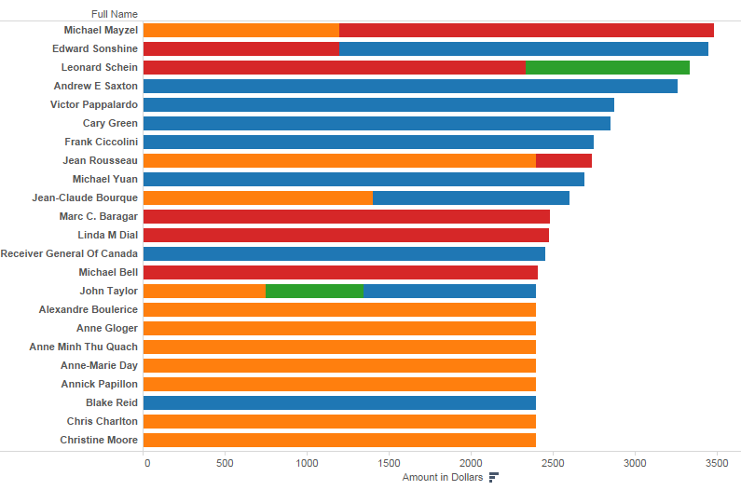
Top Individual Donations 2013

Slide 7
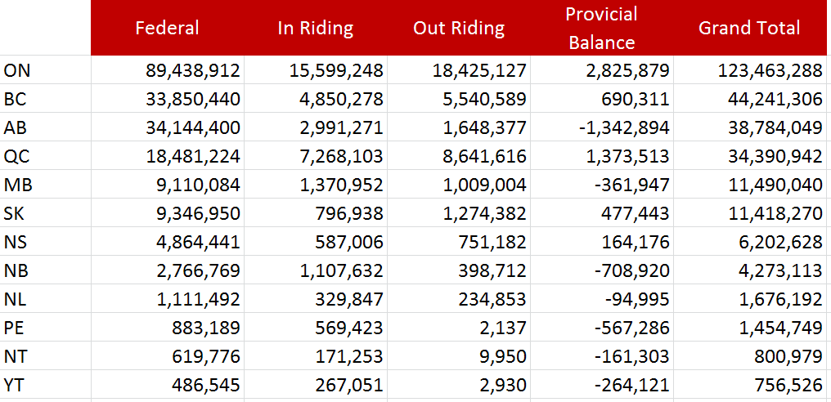
Provincial Funding Balance

Slide 11
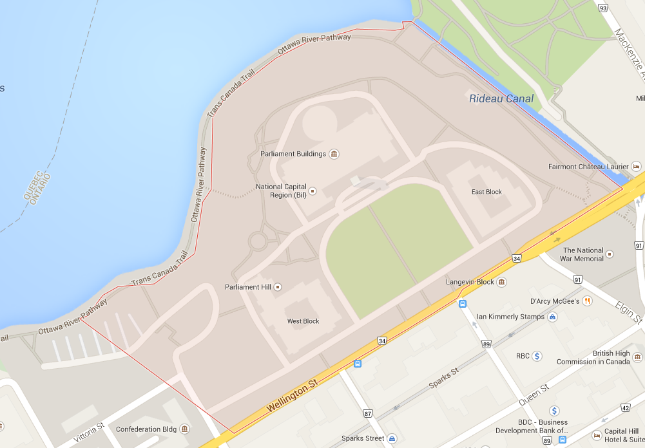
NA 1252770
K1A0A4 230897
K1A0A6 224562

Slide 12
ow id | 887630
postal_code | H0H0H0
full_name | Amanda Barry
party_riding | Liberal Party of Canada
contribution_amount | 42001
city | Miramichi
province | NB
federal_contribution | TRUE
party_name | Liberal Party of Canada
contribution_date.adjusted | 11/28/2006
flag.negative_contrib | FALSE
flag.blank_contrib | FALSE
target_riding | NA
contributors_riding_id | NA
contributors_riding_name | NA
contributor_id | 51546

